Slide 1
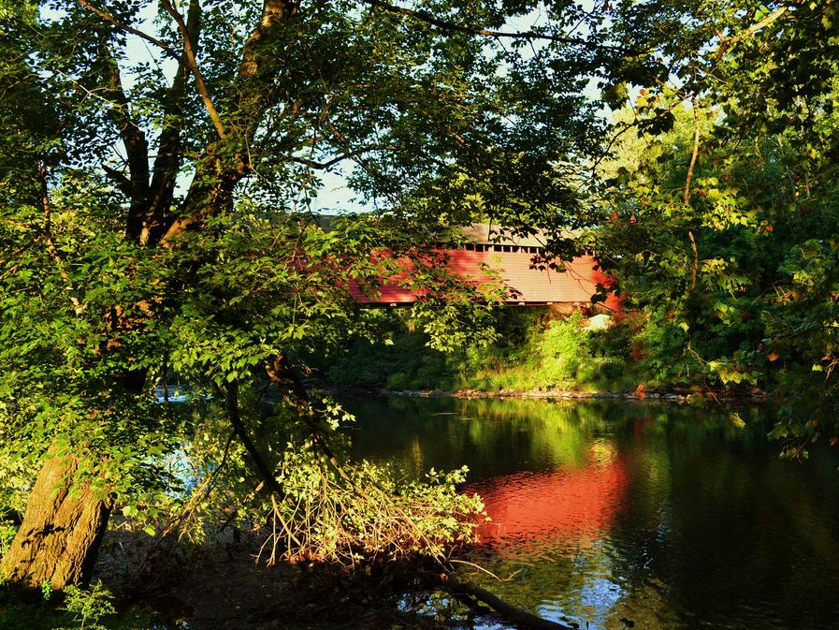
Schuylkill Action Network
A Decade of Watershed Partnership

Slide 2
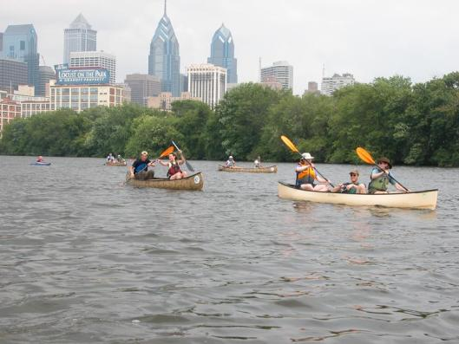
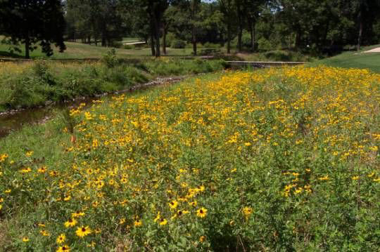
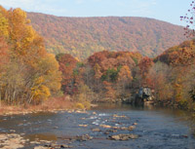
The Schuylkill River Watershed

Slide 3
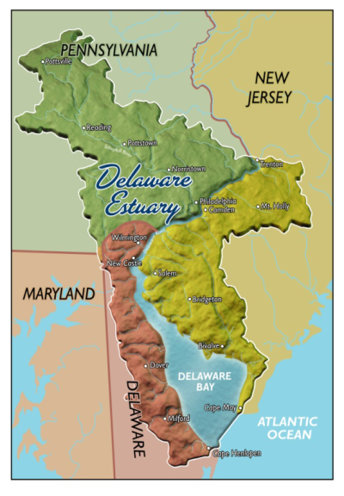
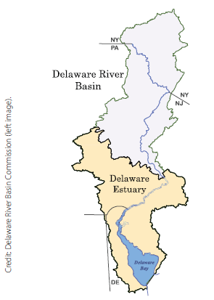
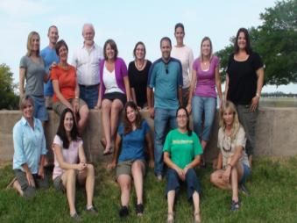
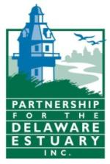
Partnership for the Delaware Estuary
Leading science-based and collaborative efforts to improve the tidal Delaware River and Bay
Focus on the Estuary, and the streams that flow into it… where the river meets the sea
Tri-state, working in Delaware, New Jersey, and Pennsylvania
One of 28 National Estuary Programs recognized by Congress for their importance to the nation

Slide 4
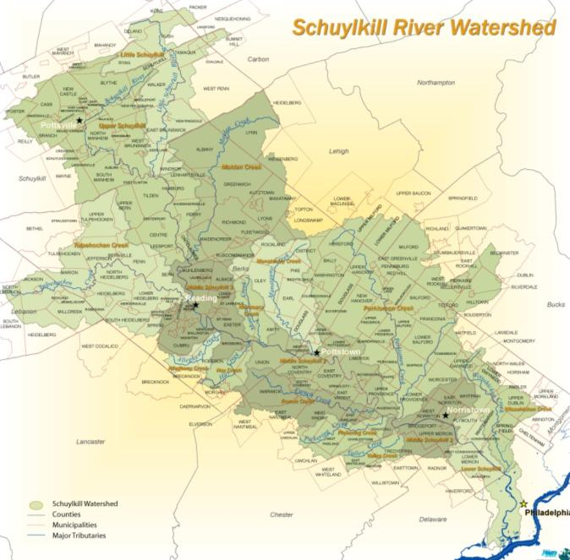
The Schuylkill Watershed
Over 2,000 square miles
3,500 regulated sources of pollution in the watershed
78 large sewage treatment plants
11 Counties, 235 Municipalities
37 Sub watersheds
2770 miles of streams and creeks
Drinking Water Source for over 2 million people.
Notes:
The Schuylkill River watershed includes
2,770 miles of streams and creeks
35% of the assessed streams in the watershed have been designated as
impaired.

Slide 5
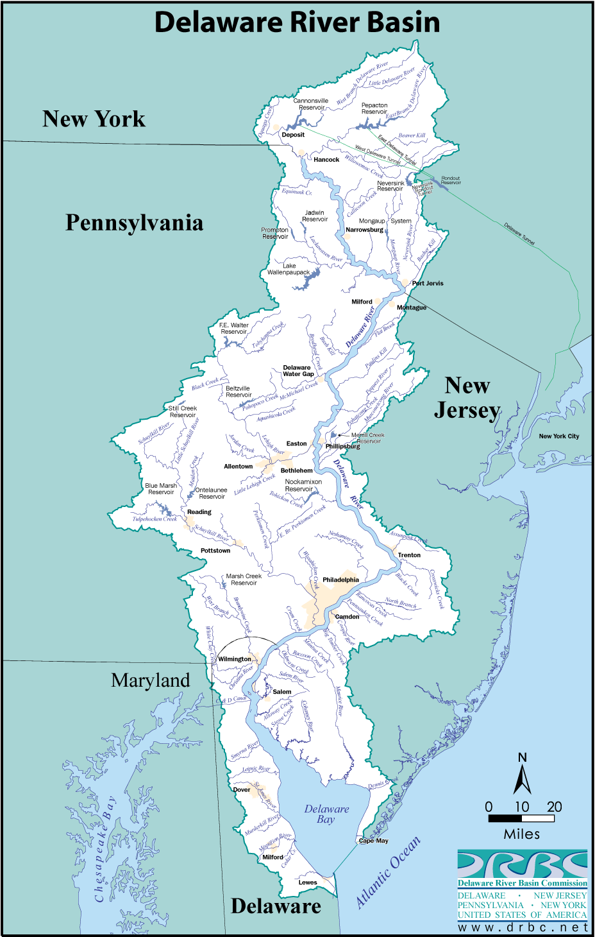
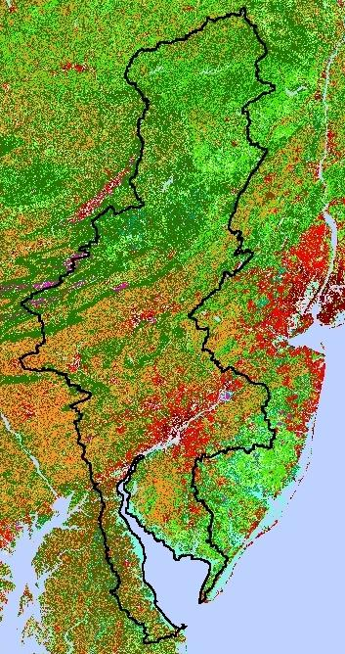
Delaware River Basin
Land Use
Forested
Agriculture
Urban
Notes:
1,000 community water systems
13,600 square miles
42 counties, 838 municipalities, 4 states
60 % forested, 24% agricultural, 9% urban and residential, and 7% surface water bodies
Population 7.5 Million
Drinking Water 15 Million People (5% of US Population)

Slide 6
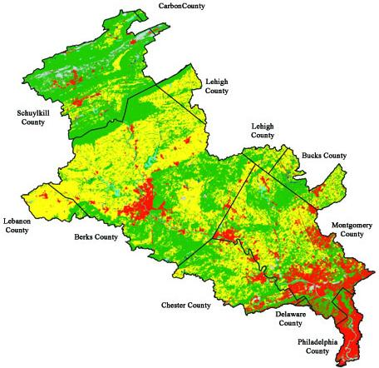
Schuylkill Watershed Land Use
Forested & Mining
Agriculture
Mixed/Developing
Urban/ Developed
Notes:
Nearly 85 percent of the watershed remains in agriculture and forest. Such uses are beneficial to the watershed, provided that good management practices, such as soil erosion and pesticide control, are also applied. By allowing rain and snow to seep into the soil, forests and well-managed agricultural lands help to replenish ground and surface waters, and sustain the health of the entire watershed ecosystem.

Slide 7
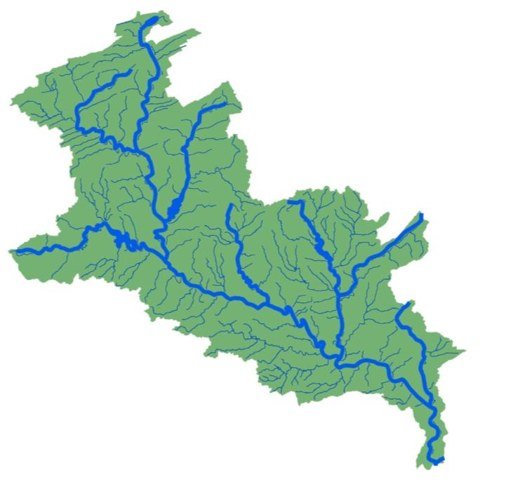
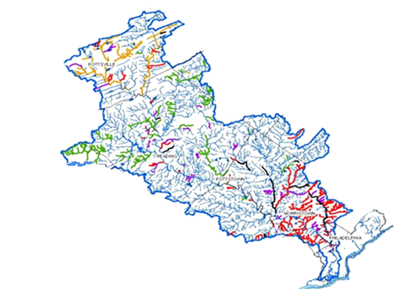
Stream Impairments
2770 Stream Miles
35% impaired

Slide 8
SAN MISSION
Members of the Schuylkill Action Network share information, expertise, and technology to help each other achieve a shared vision of clean water and a healthy environment for the Schuylkill River and its tributaries.

Slide 9
SAN Workgroups
Abandoned Mine Drainage
Agriculture
Land Protection
Pathogens/Compliance
Stormwater
Education & Outreach
Notes:
- 6 issue-specific workgroups continue to identify threats to the watershed and implement priority projects to solve them
Strategic approach to dealing with such a large amount of problems
(Identify problems, set priorities, implement projects)

Slide 10
Schuylkill Funding

Slide 11
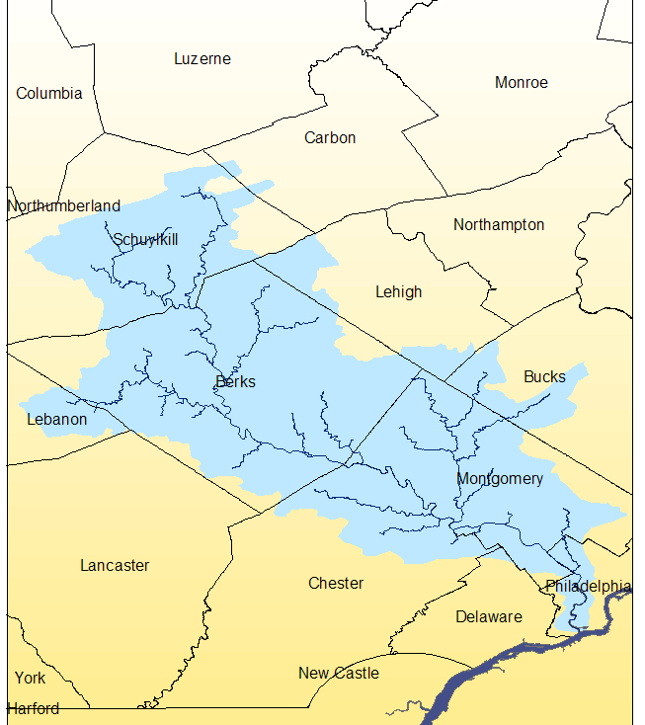



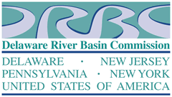

Where we got started
In 2004 the EPA awarded a $1.15 million Targeted Watershed Initiative Grant for water quality improvement and demonstration projects in the watershed
Awarded to the Partnership for the Delaware Estuary & PWD

Slide 12
Targeted Watershed Initiative Grant
The Partnership for the Delaware Estuary tracked the activities and results for over 40 projects implemented by local project managers
The Philadelphia Water Department provided network leadership, technical assistance and additional financial support for local project manager`s
An additional $2 million in PA DEP Growing Greener and other funding leveraged for an overall investment of $3 million

Slide 13
Targeted Watershed Initiative Grant
Project Funding
Agriculture $350,000
Education $360,000
Stormwater $725,000
Mine Drainage $1.2 Million

Slide 14
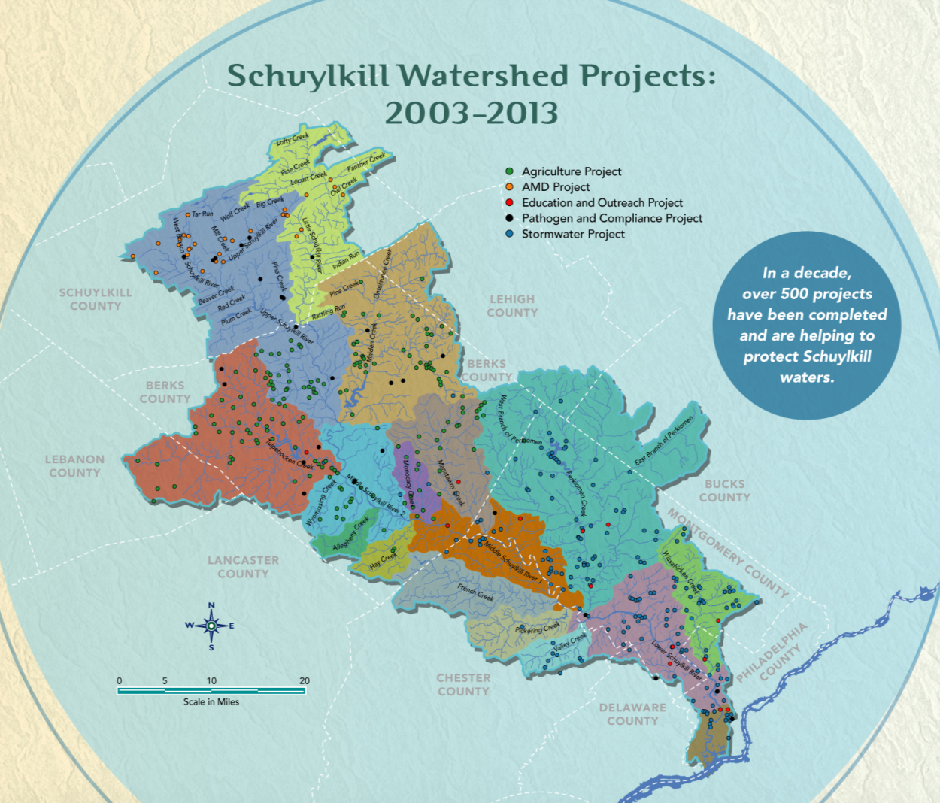
Over 500 Projects in 10 years

Slide 15
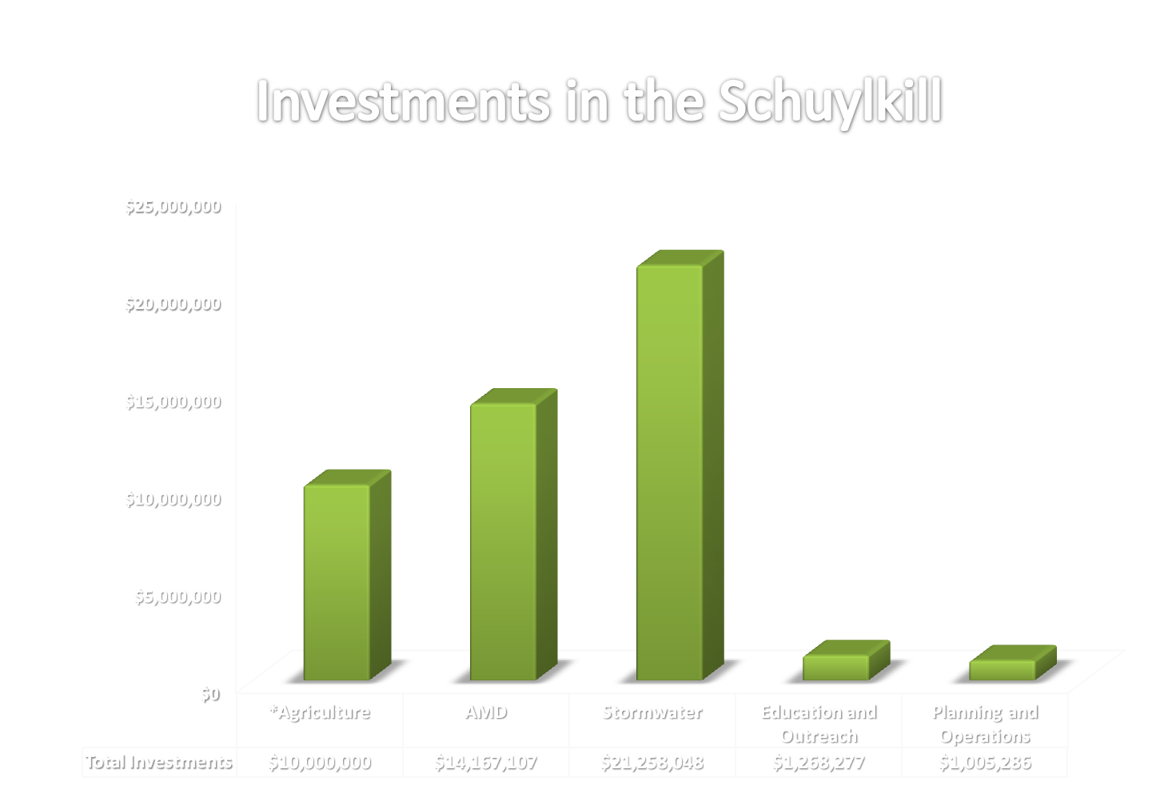
TOTAL: $412 Million
Non-Pathogen: $47 Million

Slide 16
Funders in the Schuylkill
Public Programs
Growing Greener
Coastal Zone Management
EPA Targeted Watershed Initiative
Drinking Water Fund
Clean Water Fund
EPA 319 Program
USDA Programs
PA DEP Bureau of Abandoned Mines
Office of Surface Mining
Pennvest
Fish and Boat Commission
WREN
Private Funders
William Penn Foundation
Philadelphia Water Department
Kutztown Water Authority
WBWA
RAWA
NFWF
Aqua PA
TreeVitalize
Businesses
Exelon
Saucony Creek Brewing Co.
Lehigh Anthracite

Slide 17

Current Funding in the Schuylkill
(without Pennvest funding)
Public Programs
Private Funders
Businesses

Slide 18
Optimal funding in the Schuylkill
(without Pennvest funding)
Public Programs
Private Funders
Businesses

Slide 19
Challenges of Schuylkill Funding
Large watershed need/limited resources
Piecing together various funding programs
Largely project based funding
Developing a sustainable source
Funding vs. Financing (need both)

Slide 20
Strengths of Schuylkill Funding
Diverse- No single source
Strong prioritization (project-based funding)
Funding acquired by local partners
Network provide strong ability to leverage
After 10 years- SAN well know with funders
Build into grant programs (SRRF, Growing Greener)

Slide 21
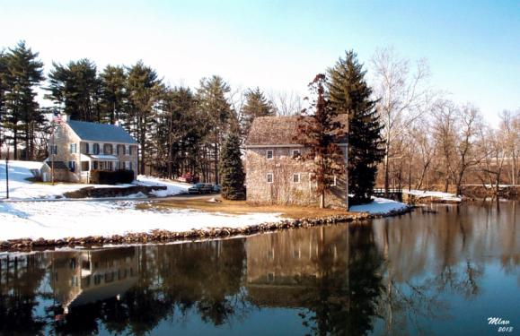
Best Practices for successful funding
Collaboration
  Source water protection funding comes in all different shapes and sizes
  Accounting for all SWP efforts
  A rising tide lifts all efforts
Prioritization
  Making the most out of limited resources
  Logical investments for funders
  Understanding the need

Slide 22
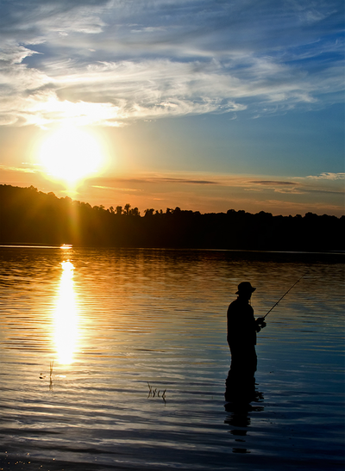
Best Practices for successful funding cont.
Evaluation
  Quantitative and Qualitative
  Benefits of articulating impact
  Make the most out of limited resources
Celebration
  Make the time for celebration
  Press and social media
  Recognize funders

Slide 23
Future of Schuylkill Funding
Seek new investors
  Focus on water users (water suppliers, businesses)
Elevating local program
  SRRF, Berks Watershed Fund, AMD O&M fund, Land Transaction Assistance Program
Marketing and Messaging
  Develop marketing plan for clean water
  Develop common message and link to funding
  Public friendly language/campaign
Exploring new opportunities
  Source water protection funding comes in all different shapes and sizes
  Think outside the box

Slide 24
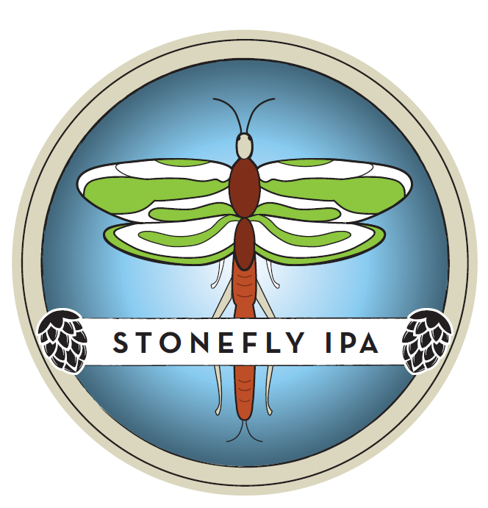
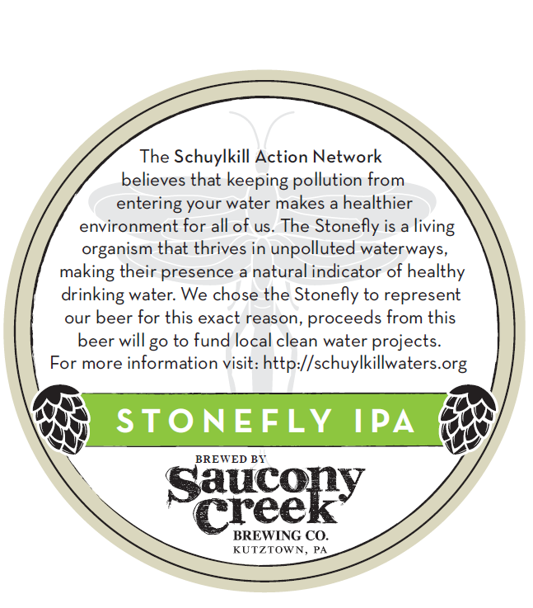
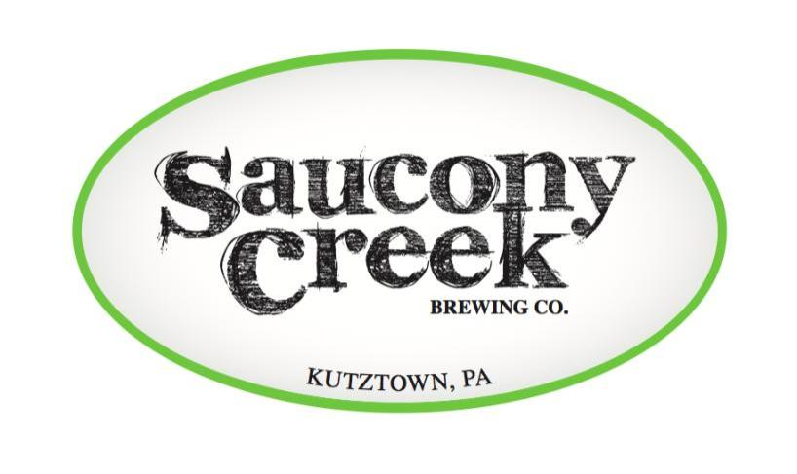
Looking for new opportunities

Slide 25
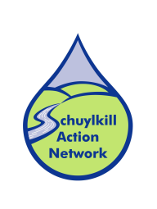
Contact Info
Tom Davidock
SAN Coordinator
Partnership for the Delaware Estuary
(302) 655-4990
tdavidock@DelawareEstuary.org
www.SchuylkillWaters.org

