Slide 1
United Water Delaware
“Cut the Crypto”
Watershed Control Plan
Nancy Trushell, P.E.
Director of Engineering
United Water Delaware

Slide 2
Crypto 0.079 oocysts/L Detected
BIN 2 > 0.075 to <1.00 oocysts/L requires additional 1-log removal credit
Combined Filter (CFE) Performance
0.5-log credit
If CFE turbidity < 0.15 NTU in 95% of all monthly measurements
Watershed Control Plan (WCP)
0.5-log credit
Annual report demonstrating Crypto. reduction/avoidance

Slide 3
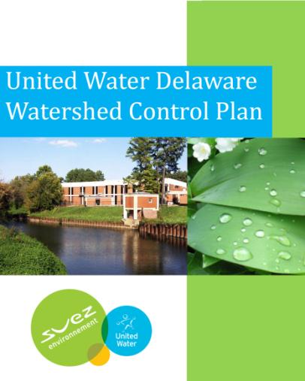
What is the Watershed Control Plan?
EPA compliance option for
LT2ESWTR = 1/2 log
credit
5 year plan to identify,
reduce and avoid future
cryptosporidium loading
upstream of treatment
plant
14 structural and 11 non-
structural projects
7 partnering entities

Slide 4
Challenges and Concerns
Novelty of approach – unchartered
territory, first WCP in 5 states
under EPA Region 3 jurisdiction
Largest loading of crypto. is
occurring in out of state
portions of watersheds
We don’t own watershed
Identifying and financing projects
Willingness of property owners
to agree to projects

Slide 5
UWDE’s WCP Approach
Collaborate with upstream partners
Make key investments in incremental long term improvements
Provide technical, and/or financial assistance to the stakeholders with the capability to successfully plan and implement a specific project
Provide the groundwork for leveraging the use of other funding sources to broaden the impact of direct investments

Slide 6
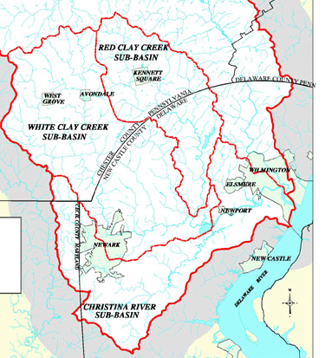
Source Identification
Involved the following activities:
Stakeholder outreach
Watershed surveys
Review of existing regulatory databases
Review of reports, studies, TMDLs
Analysis of water quality monitoring data
Estimates of loadings from sources or geographical areas

Slide 7
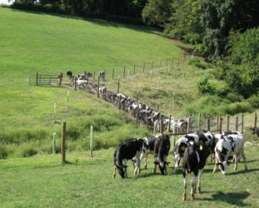
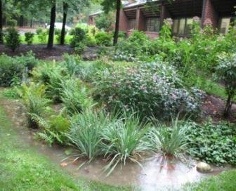
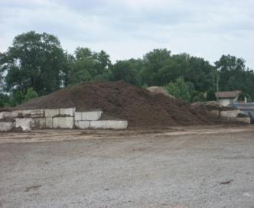
Project Types
Agricultural
Mushroom Industry Manure
Management
Storm water
Riparian Buffer
Sewage
Treatment
Education

Slide 8
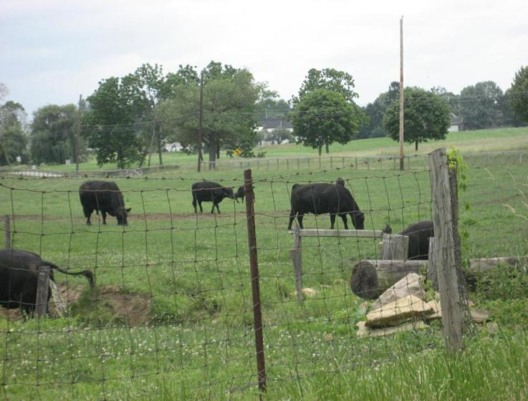
Agricultural

Slide 9
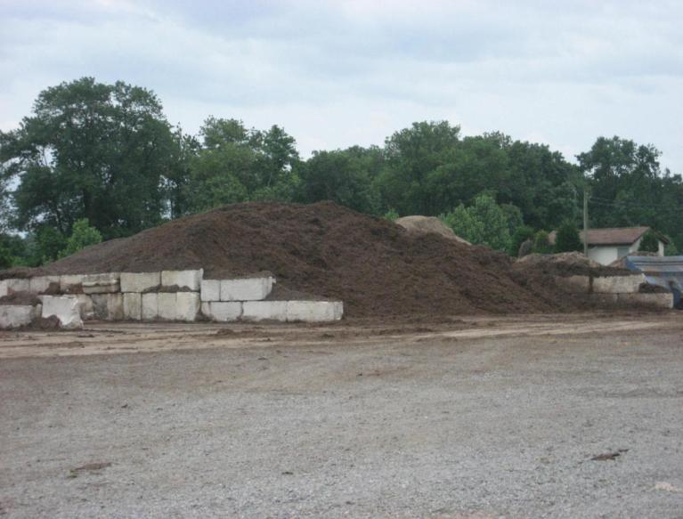
Manure Management

Slide 10
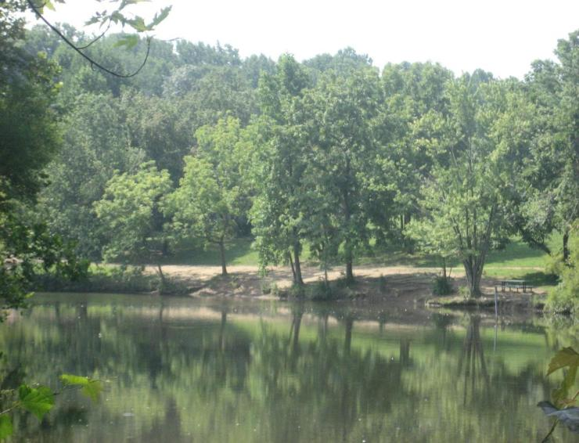
Stormwater – Dog Waste

Slide 11
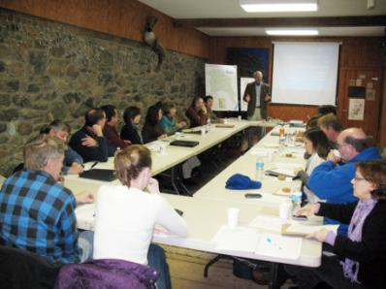
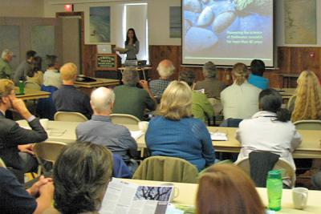
Secrets of Success
Started early – demonstrated progress/project success early
Relationship building/management - regulators and partners
Close and continued communication with regulators
Close and continued communication with partners – project ID and completion –focus and synergy
Consulting expertise

Slide 12
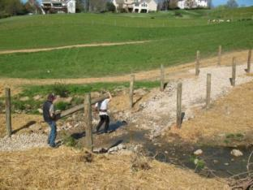
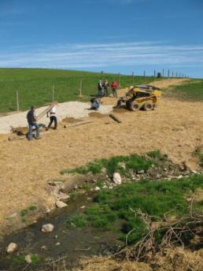
Initial Project – Barclay Hoopes Farm
60 acres on White Clay
Creek tributary
120 cows – total stream
access
1500 feet of streambank
fencing installed
stream access reduced to
2 Crossings and 1 watering
area
35 foot vegetative buffers
on either side of stream
established and trees
planted to stabilize banks

Slide 13
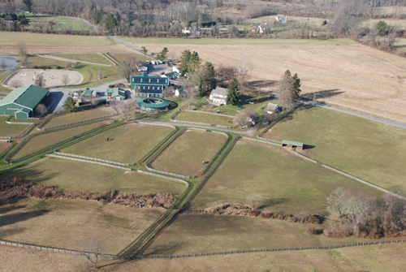
Fall 2013 Project – Derbydown
active horse farm/training
facility on tributary of Red Clay
Creek near Kennett Square
approximately 25 horses and
cows on site – cattle for steer
roping training
farm animals have direct access
to stream and pasture runoff can
easily enter stream w/o filtering
Red Clay Valley Association is
lead project partner
Chester County Conservation
District providing technical
assistance

Slide 14
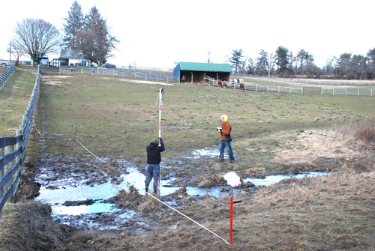
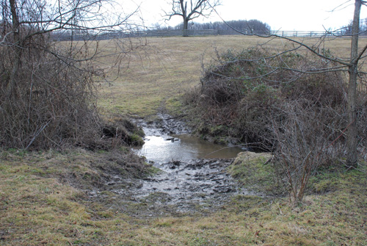
Fall 2013 Project – Derbydown
control measure: 500 feet of
stream bank fencing
five crossings and two
water access points
Tree buffer to be planted
between fencing and
stream
Streambanks afforded
protection from further
erosion

Slide 15
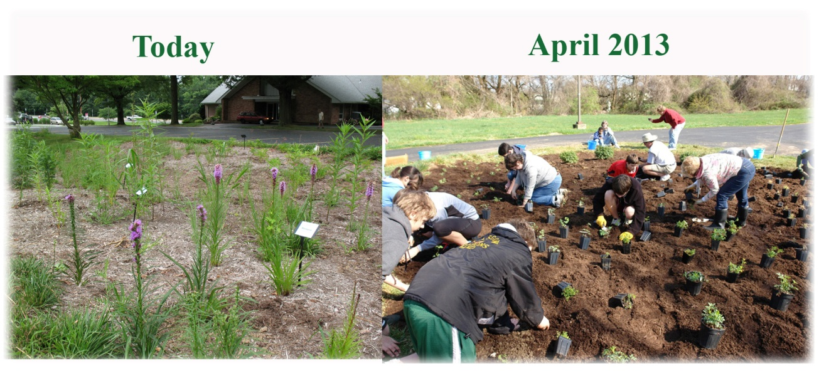
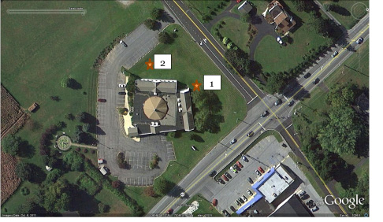
Rain Garden Projects
Limestone Presbyterian
Church
1600 square feet
Treats 5 acres of runoff
White Clay watershed
Grace Lutheran Church
October 2013 target date
Size/drainage area TBD
rooftop and parking lot runoff
DNREC Rain Gardens for the Bays is lead partner with church
Red Clay watershed

Slide 16
Benefits of WCP Approach
Benefits environment
Compliance without increased
carbon footprint of treatment
plant
WCP projects also reduce other
pollution – fertilizer runoff,
reduce erosion
Attains compliance while saving a
minimum of $4 million in capital
spend and varying amounts of
annual operating costs
Attains compliance while keeping
customer costs down
Benefits partners’ missions/
provides them resources and focus

Slide 17
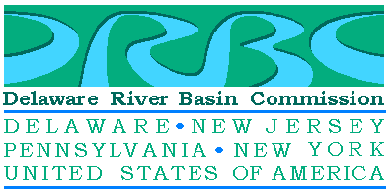
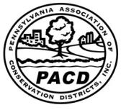
Benefits of WCP Approach –
Stakeholder and Public Awareness
Social media – over 1000 hits on
video posted on YouTube and
Content Delaware websites
Delaware River Basin Commission
EPA Annual States Conference – five
states and DC regulators
Statewide awareness in Pennsylvania
through PACD (Pennsylvania
Association of Conservation
Districts) publication and 2013
PACD bus tour presentation
Face Book - CCCD posting
Web link to video on largest Delaware
nature organization’s website - DNS

Slide 18
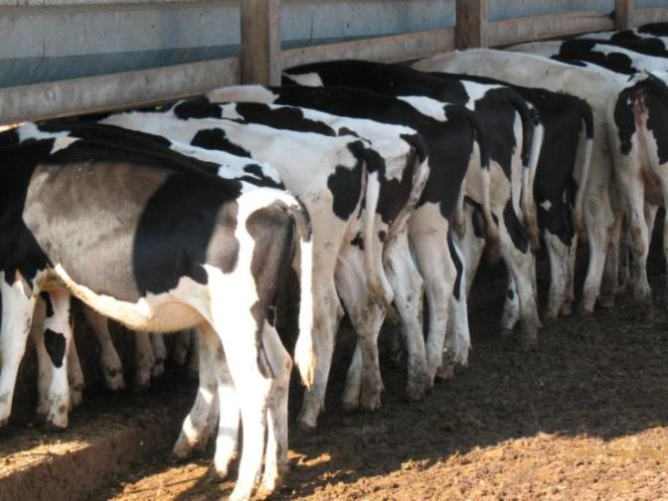
THE END - QUESTIONS?

Slide 19
United Water Delaware
“Cut the Crypto”
Watershed Control Plan

