Slide 1

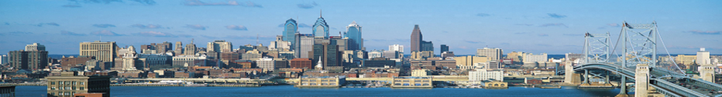
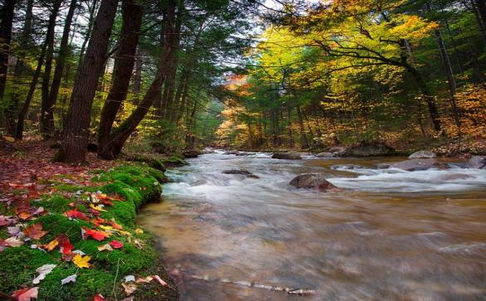
EPA Region 2 & Region 3
September 2014 Webinar Presentation
DELAWARE RIVER WATERSHED INITATIVE
Accelerating Conservation, Assessing Impact
featuring
NJ HIGHLANDS CLUSTER
Association of New Jersey Environmental Commissions
Hunterdon Land Trust
Musconetcong Watershed Association
New Jersey Audubon Society
New Jersey Conservation Foundation
New Jersey Highlands Coalition
North Jersey RC&D
The Land Conservancy of New Jersey
The Nature Conservancy
Trout Unlimited
Trust for Public Lands
Wallkill River Watershed Management Group

Slide 2
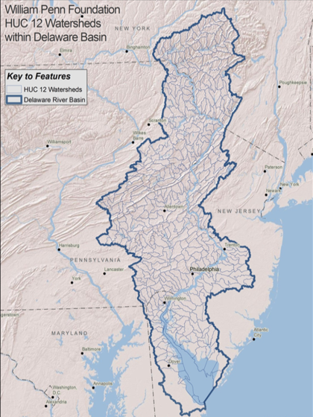
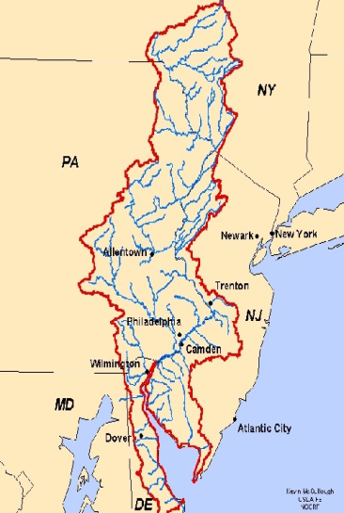
Delaware River Watershed
… an extraordinary resource
                Spans 13,500 sq. miles
                Provides drinking water for ~ 15M people
                Enables $25B/yr business
                Supports globally rare species & habitats
                Offers abundant recreation

Slide 3
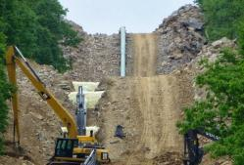
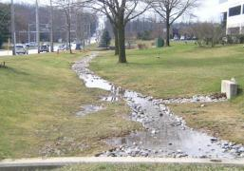
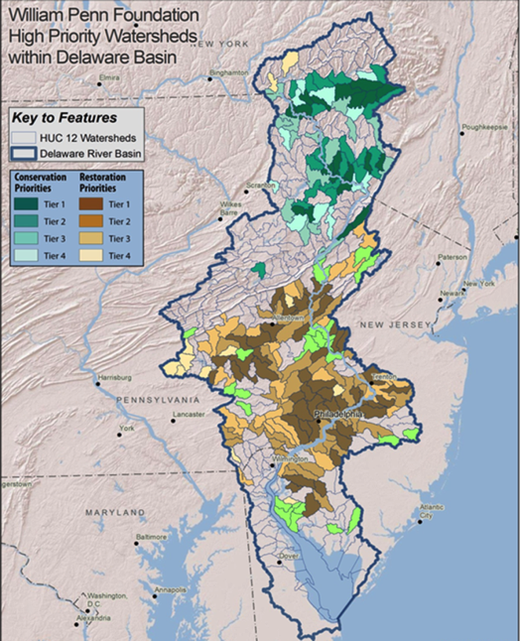
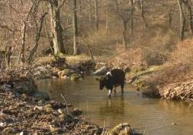
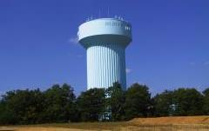
Targeting specific
watershed stressors:
  Headwaters Forest loss/fragmentation
  Stormwater run-off (volume & NPSP)
  Agricultural run-off (NPSP & volume)
  Sustainable aquifer (pollution & depletion)
(source: DRN)
(source: PEC)
(source: BCC)
(source: PPA)

Slide 4
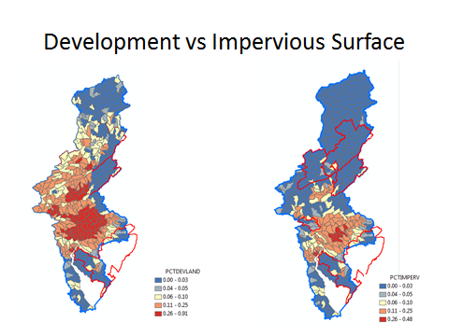

Slide 5

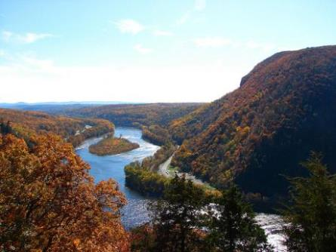
Criteria for Watershed Investments
Potential for Significant Impact
Urgency to Act
Organization Capacity
Cost Efficiency
Ability to Measure Impact
Delaware Water Gap National Recreation Area

Slide 6
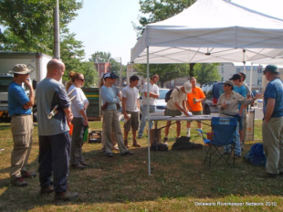
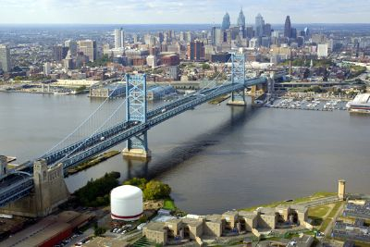
Target and Prioritize places and issues, driven by science and data
Identify baseline and changing conditions
Fund strong and effective organizations
Monitor change and impact of interventions
Leverage other work by public and private funders
Share learning to strengthen impact, encouraging replication

Slide 7
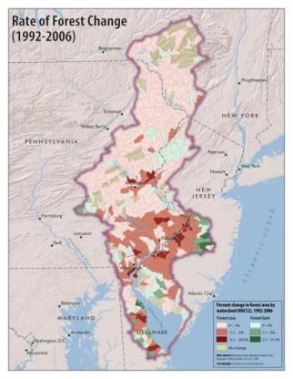
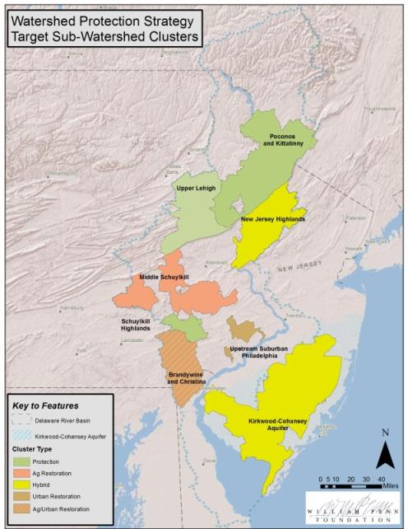








Delaware River Watershed Initiative - Clusters
GOAL:
Ensure a
sufficient supply of clean water through ecosystem services
provided by adequately
protected and restored
watersheds

Slide 8
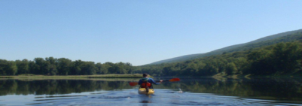
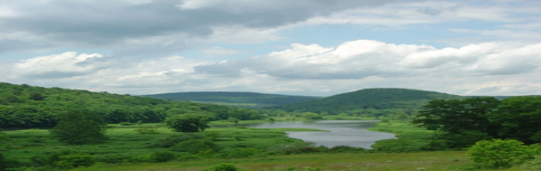
INITATIVE’S FOUNDATIONAL CORNERSTONES
Targeting – can work be focused to ensure cumulative benefits ?
Scale - can work make a difference given the scale & stressors of the place or issue ?
Metrics – how will we know if the work is successful (or not) ?
Replication – strategy to expand successful work ?
Capacity – can someone delivering work at a scale to have impact ?
Alignment/Leverage – can work align to magnify impact/improve efficiency/effectiveness ?
Notes:
For us, the question was – how do we use the Foundation’s funds to maximize impact?
And how will we know that we’re succeeding?
As we designed our watershed protection grantmaking strategy, these are questions we wanted to be able to address.

Slide 9
2014 – Wm PENN FOUNDATION granted :
OVER $35M in OP & CAPITAL FUNDS (3-yr investment)
OF WHICH $9M is via OSI for COMPETETIVE LAND PROTECTION CAPITAL
$7M is via NFWF for COMPETETIVE RESTORATION CAPITAL
& OVER $14M is for 3-YR OPERATIONAL FUNDS to 43 CONSERVATION NONPROFITS

Slide 10
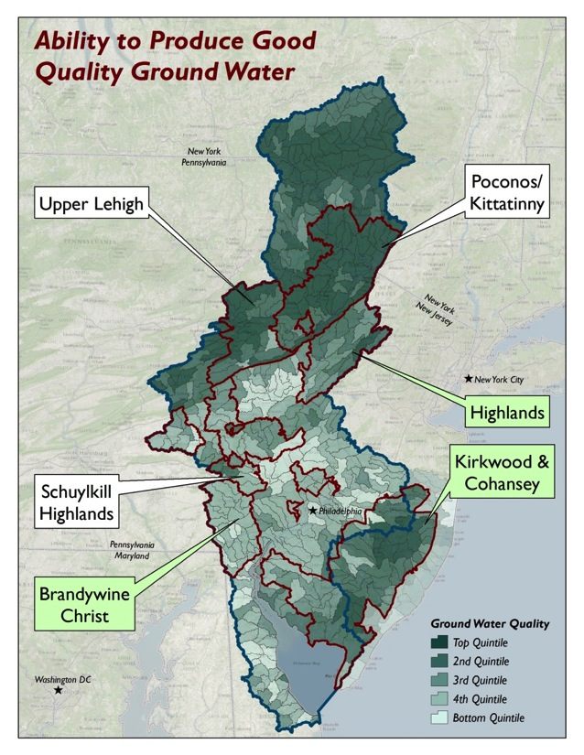
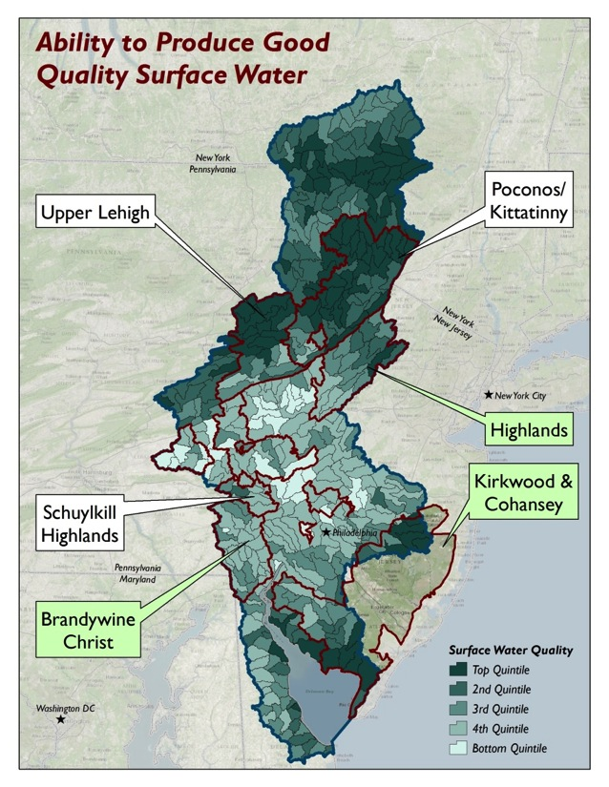
4

Slide 11
